Slide 1
Course Name: Machine Learning for Theory and Practices(CSE 623) Group Details: Rampal Singh (AU 2449006)
Project Name:
Predicting Tensile Strength in 3D-Printed Materials using Linear Regression AdaBoost Regression XGBoost Regression ,Gradient Boosting Regression Random Forest Regression

Slide 2
Problem statement
The mechanical properties of 3D-printed components, particularly tensile strength, are significantly influenced by various process parameters such as layer height, infill density, nozzle temperature, print speed, and wall thickness.
This project focuses on developing a machine learning-based predictive model that can accurately estimate tensile strength based on these key input parameters. By doing so, it enables the optimization of 3D printing settings for enhanced durability, strength, and performance.
Multiple regression models were explored, including Random Forest, XGBoost, Gradient Boosting, and Linear Regression. After rigorous evaluation and hyperparameter tuning, the best-performing model was selected for accurate prediction.
The final model also includes feature importance analysis and SHAP-based interpretation to understand the influence of each parameter on tensile strength, making it a valuable tool for real-world additive manufacturing applications.

Slide 3
Literature Survey
Title | Authors | Key Parameters | ML Methods | Main Findings | Limitations
Accurate Estimation of Tensile Strength of 3D Printed Parts Using Machine Learning Algorithms | Jayasudha et al. | Extrusion temperature, layer height, shell thickness, build orientation | Linear Regression, Random Forest, AdaBoost, Gradient Boosting, XGBoost | XGBoost outperformed others (R²: 0.94–0.97). Tensile strength correlates strongly with extrusion temperature. | Limited to two case studies; hyperparameters not globally optimized.
Predicting the Dimensional Variation of Geometries Produced Through FDM 3D Printing | Sharma et al. | Wall thickness, infill density, print speed, material (ABS/PLA) | Decision Tree Regression | PLA exhibits higher dimensional variation than ABS. Achieved R² = 0.67 for dimensional accuracy prediction. | Moderate R² score; limited to FDM and specific geometries.
Predicting Three-Dimensional (3D) Printed Part Quality with Machine Learning-Based Regression Methods | Tatar | Layer height, nozzle/bed temperature, infill density, material (PLA/ABS), fan speed | Gaussian Process Regression (GPR), SVM, MLP, Random Forest, Linear Regression | GPR achieved highest accuracy (R²: 0.98–1.00). MLP offered fastest prediction (6,700 obs/sec). | Computationally intensive for GPR; dataset limited to Kaggle’s open-source.
Automated Process Monitoring in 3D Printing Using Supervised Machine Learning | Delli & Chang | Layer thickness, material (ABS/PLA), checkpoints, image analysis | SVM (classification) | Detects structural and completion defects with 93-100% accuracy. Reduces material waste by early defect detection. | Requires pausing printing; limited to top-view defect detection.

Slide 4
Literature Survey
Title | Authors | Key Parameters | ML Methods | Main Findings | Limitations
Detecting Malicious Defects in 3D Printing Process Using Machine Learning and Image Classification | Wu et al. | Infill patterns (honeycomb, concentric, etc.), defect types (seam, irregular polygon, circle, rectangle, triangle), grayscale features (mean, SD, pixel count) | Naive Bayes Classifier, J48 Decision Trees | J48 achieved 95.51% accuracy in detecting malicious infill defects. Features extracted from simulated layer-by-layer images. | Tested only on simulated images; limited to honeycomb infill patterns; defects not validated in physical environments.

Slide 5
Dataset Discussion
Aspect | Details
Dataset Source | Experimental data collected from kaggle and Research papers
Features Considered | - Wall Thickness
 | - Infill Density
 | - Layer Height
 | - Bed Temperature
 | - Nozzle Temperature
 | - Fan Speed
 | - Print Speed
Target Variable | Tensile Strength
Data Pre-processing Steps | - Removed non-numeric data
 | - Handled missing values by imputing with the column mean
 | - Split data into training (80%) and testing (20%) sets
Source of kaggle data -https://www.kaggle.com/datasets/afumetto/3dprinter?select=data.csv

Slide 6
Data Pre-processing
Dropped irrelevant labels like Roughness and Elongation (not the current target)
Removed non-numeric or redundant features
Encoded categorical features like Material and Infill Pattern
Handled missing values using mean imputation
The Infill Pattern was excluded from the model due to its low correlation coefficient of 0.28 with Tensile Strength, indicating a weak relationship. It was also seldom cited in relevant 3D printing research as a significant factor.

Slide 7
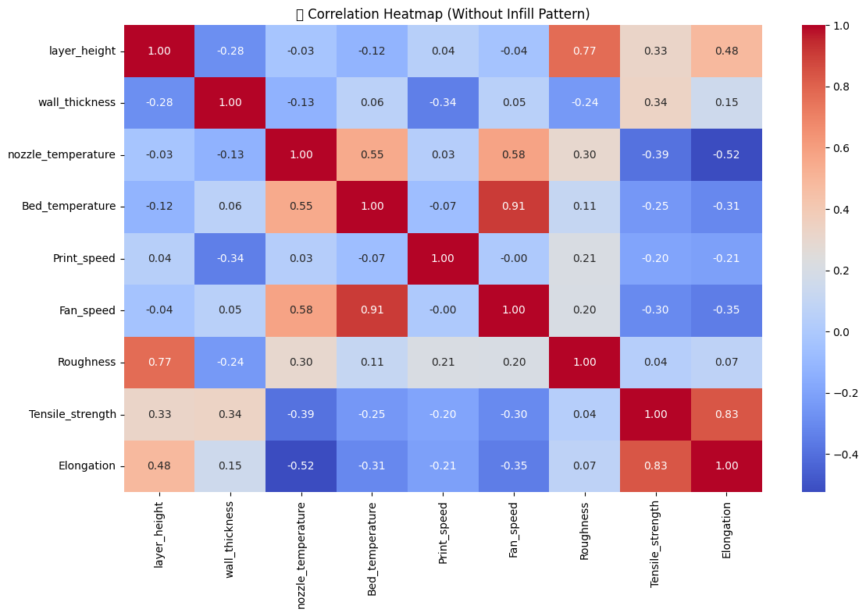
5. Exploratory Data Analysis (EDA)

Slide 8
Model | R² (Train) | R² (Test) | MSE (Train) | MSE (Test) | performance of model trained on kaggle data
Linear Regression | 0.5482 | 0.6423 | 40.3381 | 21.5732
AdaBoost Regression | 0.8606 | 0.603 | 12.4491 | 23.9409
XGBoost Regression | 1 | 0.6589 | 0.0002 | 20.5727
Gradient Boosting Regression | 0.9618 | 0.7062 | 3.4153 | 17.7187
Random Forest Regression | 0.9382 | 0.7891 | 5.5207 | 12.7192
Model | R² (Train) | R² (Test) | MSE (Train) | MSE (Test) | perfromance of model trained and research paper
Linear Regression | 0.5469 | 0.6785 | 24.7431 | 17.5779
AdaBoost Regression | 0.8077 | 0.7719 | 10.5028 | 12.4723
XGBoost Regression | 1 | 0.8042 | 0.002 | 10.7058
Gradient Boosting Regression | 0.9405 | 0.8734 | 3.2511 | 6.9228
Random Forest Regression | 0.9276 | 0.8152 | 3.9549 | 10.1049

Slide 9
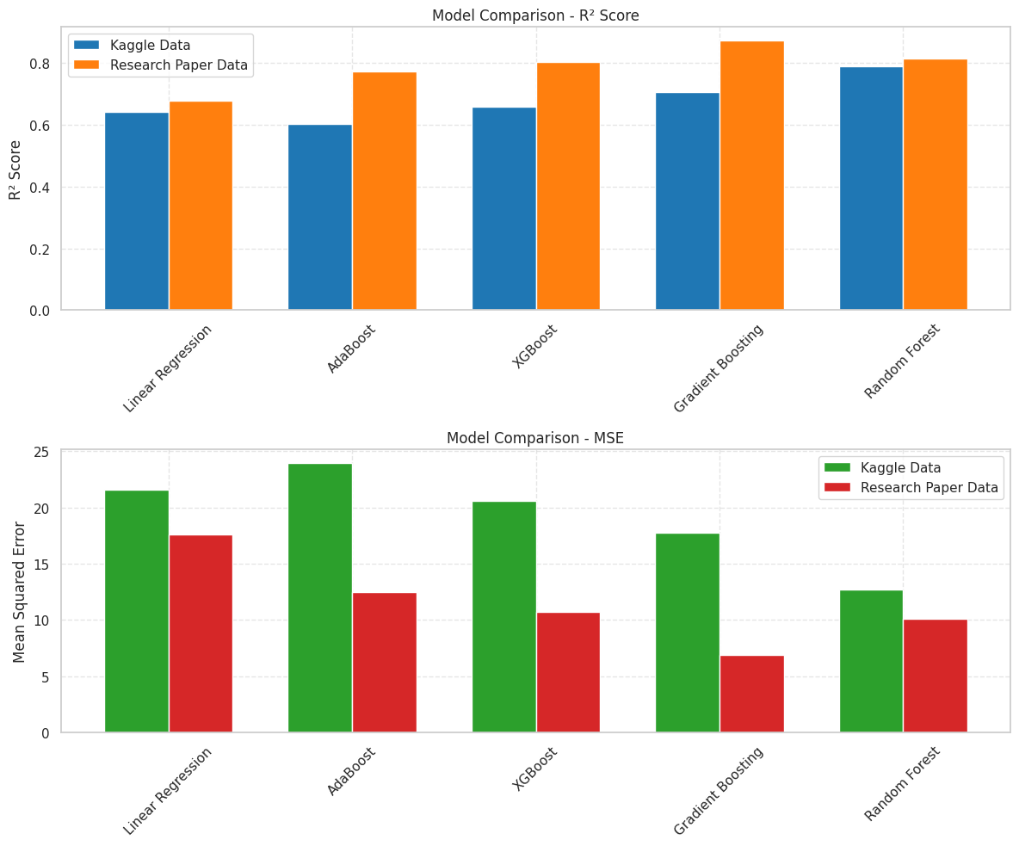

Slide 10
Model Evaluation & Results
train vs. test R², MSE
Model | R² (Train) | R² (Test) | MSE (Train) | MSE (Test)
Linear Regression | 0.5469 | 0.6785 | 24.7431 | 17.5779
AdaBoost Regression | 0.8077 | 0.7719 | 10.5028 | 12.4723
XGBoost Regression | 1 | 0.8042 | 0.002 | 10.7058
Gradient Boosting Regression | 0.9405 | 0.8734 | 3.2511 | 6.9228
Random Forest Regression | 0.9338 | 0.8111 | 3.6165 | 10.3271

Slide 11
CROSSFLOD VALIDATION
Model | Test R² (Without CV) | Test R² (CV) | Test MSE (Without CV) | Test MSE (CV)
Linear Regression | 0.6785 | 0.9181 | 17.5779 | 23.7128
AdaBoost Regression | 0.7719 | 0.8822 | 12.4723 | 33.9169
XGBoost Regression | 0.8042 | 0.8649 | 10.7058 | 39.0028
Gradient Boosting Regression | 0.8734 | 0.8761 | 6.9228 | 35.7538

Slide 12
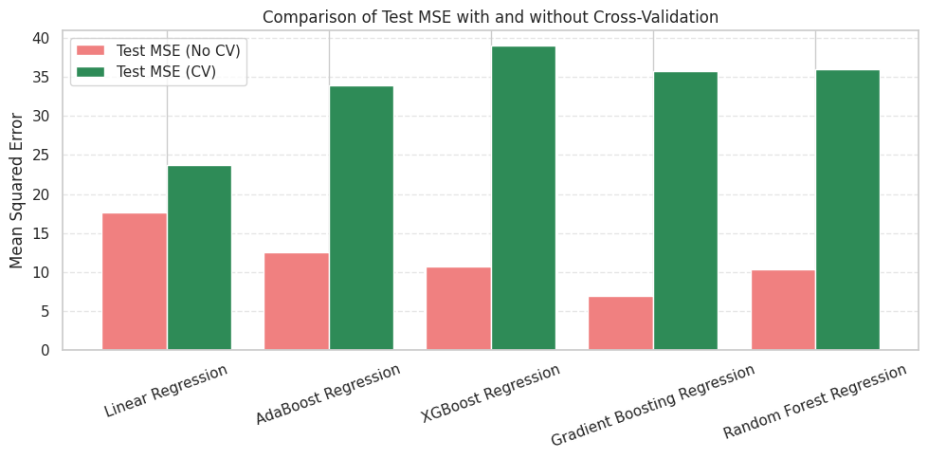

Slide 13
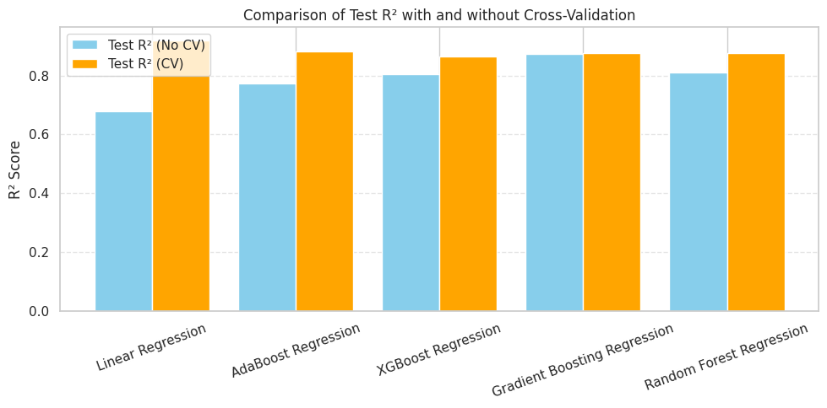

Slide 14
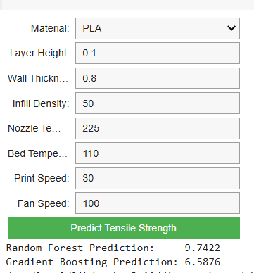
User interface to predict tensile strength

Slide 15
Model | Search Method | Best Parameters | R² Score (Test) | MSE (Test)
AdaBoost Regression | RandomizedSearchCV | {'learning_rate': 0.1896, 'n_estimators': 152} | 0.7790 | 12.0794
 | GridSearchCV | {'learning_rate': 1.0, 'n_estimators': 200} | 0.7741 | 12.3495
XGBoost Regression | RandomizedSearchCV | {'learning_rate': 0.1952, 'max_depth': 4, 'n_estimators': 71} | 0.8787 | 6.6319
 | GridSearchCV | {'learning_rate': 0.2, 'max_depth': 3, 'n_estimators': 200} | 0.8825 | 6.4257
Gradient Boosting | RandomizedSearchCV | {'learning_rate': 0.1952, 'max_depth': 4, 'n_estimators': 71} | 0.9070 | 5.0861
 | GridSearchCV | {'learning_rate': 0.2, 'max_depth': 3, 'n_estimators': 200} | 0.8251 | 9.5616
Random Forest Regression | RandomizedSearchCV | {'max_depth': 20, 'min_samples_leaf': 2, 'min_samples_split': 4, 'n_estimators': 124} | 0.7964 | 11.1311
 | GridSearchCV | {'max_depth': None, 'min_samples_split': 2, 'n_estimators': 100} | 0.8278 | 9.4160
Linear Regression | GridSearchCV | Default parameters used (no tuning) | 0.6785 | 17.5779

Slide 16
Hyper parameter tuning
Random Forest Regression
Metric | Before Tuning | After GridSearchCV | After RandomizedSearchCV
R² Score | 0.89 (initial est.) | 0.9751 | 0.9761
MSE | High (initial) | 145.6 | 140
Model | Method | Best Parameters
AdaBoost | GridSearchCV | {'n_estimators': 100, 'learning_rate': 0.1}
GradientBoosting | GridSearchCV | {'n_estimators': 100, 'learning_rate': 0.1, 'max_depth': 5}
Random Forest | RandomizedSearchCV | {'n_estimators': 96, 'max_depth': None, 'min_samples_split': 2}
XGBoost | GridSearchCV | {'n_estimators': 100, 'learning_rate': 0.1, 'max_depth': 5}

Slide 17
R^2 comparison before and after hyper parameter tuning
Model | Before Tuning | After Tuning (GridSearchCV) | After Tuning (Randomized SearchCV)
AdaBoost | 0.7719 | 0.7741 | 0.779
Gradient Boosting | 0.8734 | 0.8251 | 0.906966
Random Forest | 0.8111 | 0.8278 | 0.796391
XGBoost | 0.8042 | 0.8825 | 0.878691

Slide 18
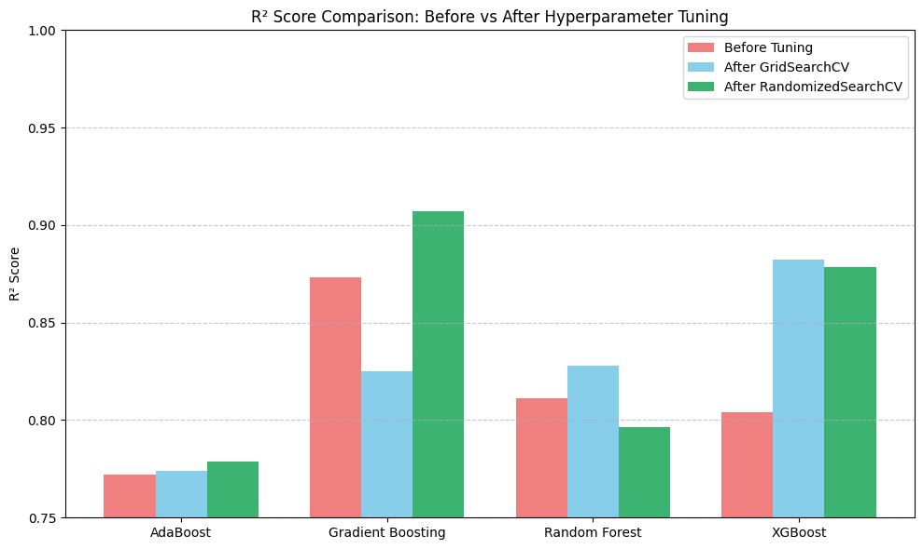
R^2 comparison before and after hyper parameter tuning

Slide 19
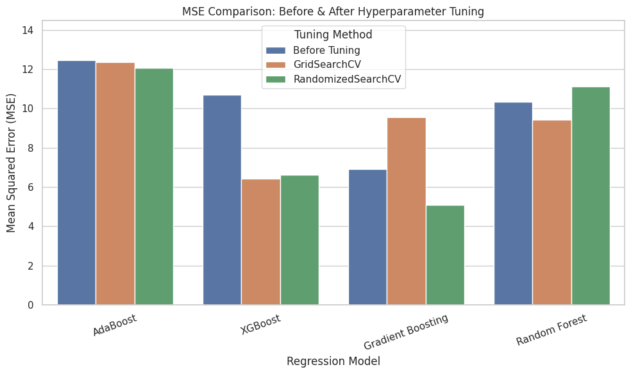

Slide 20
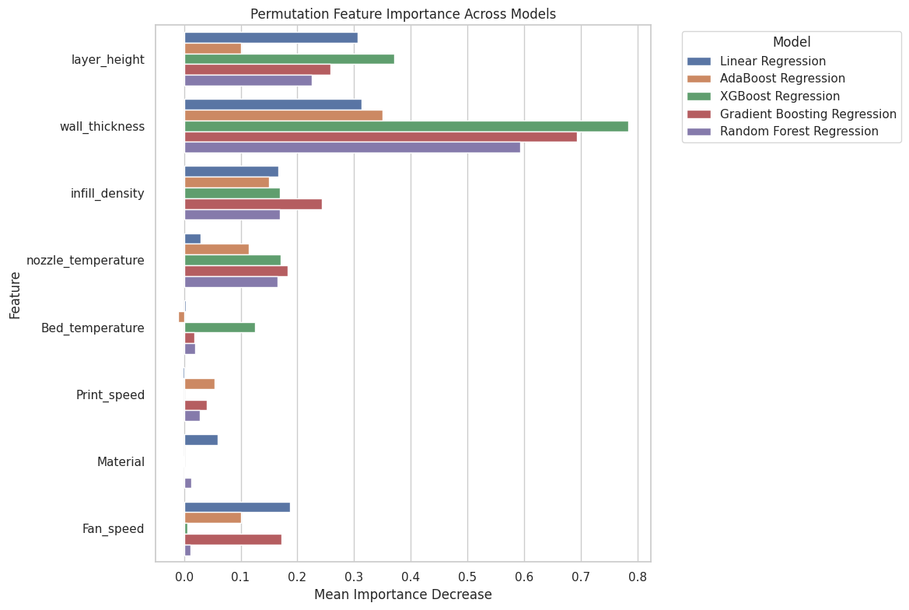

Slide 21
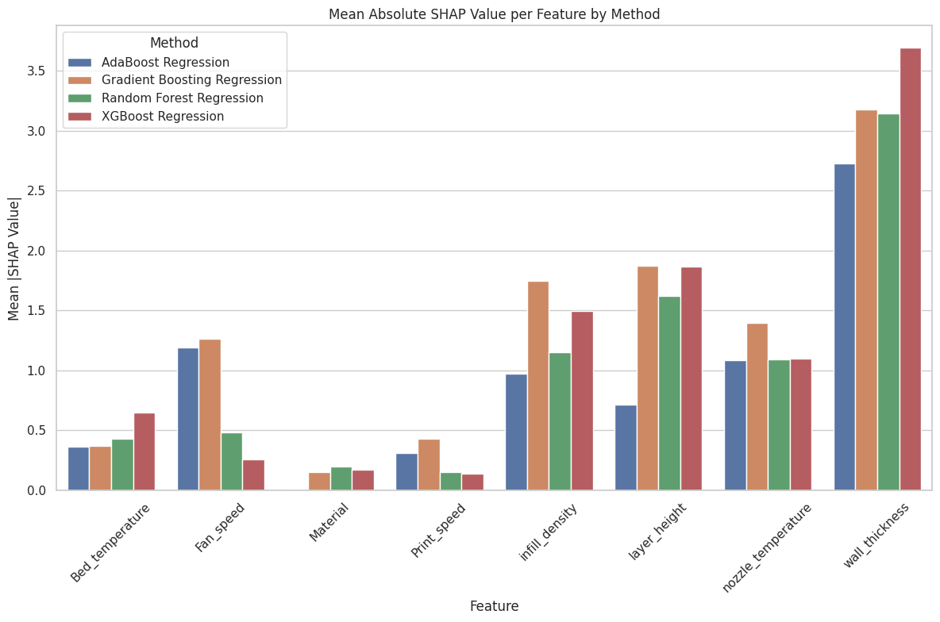

Slide 22
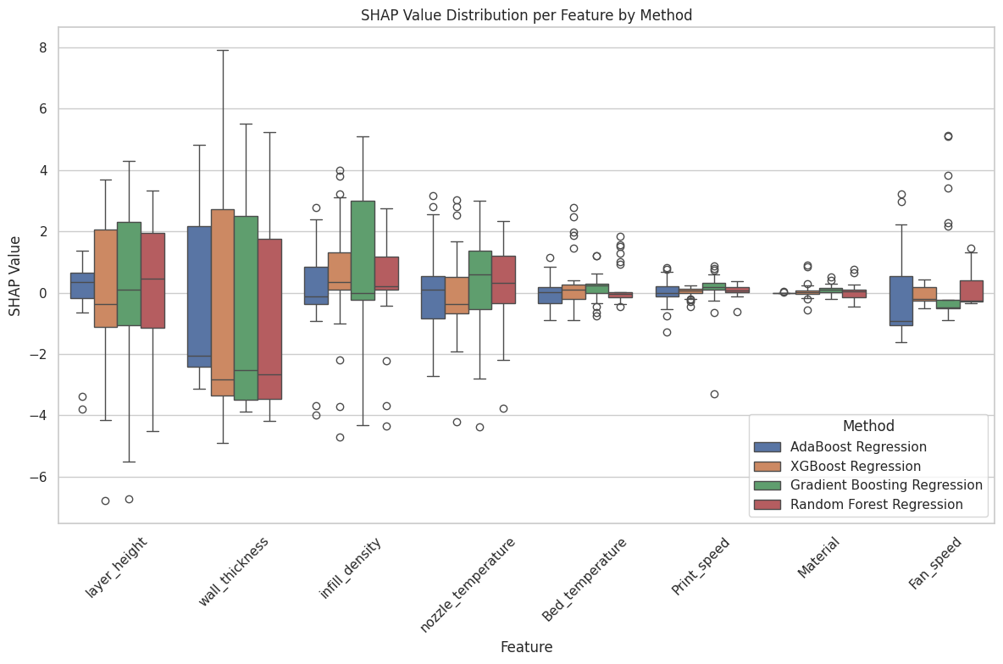

Slide 23
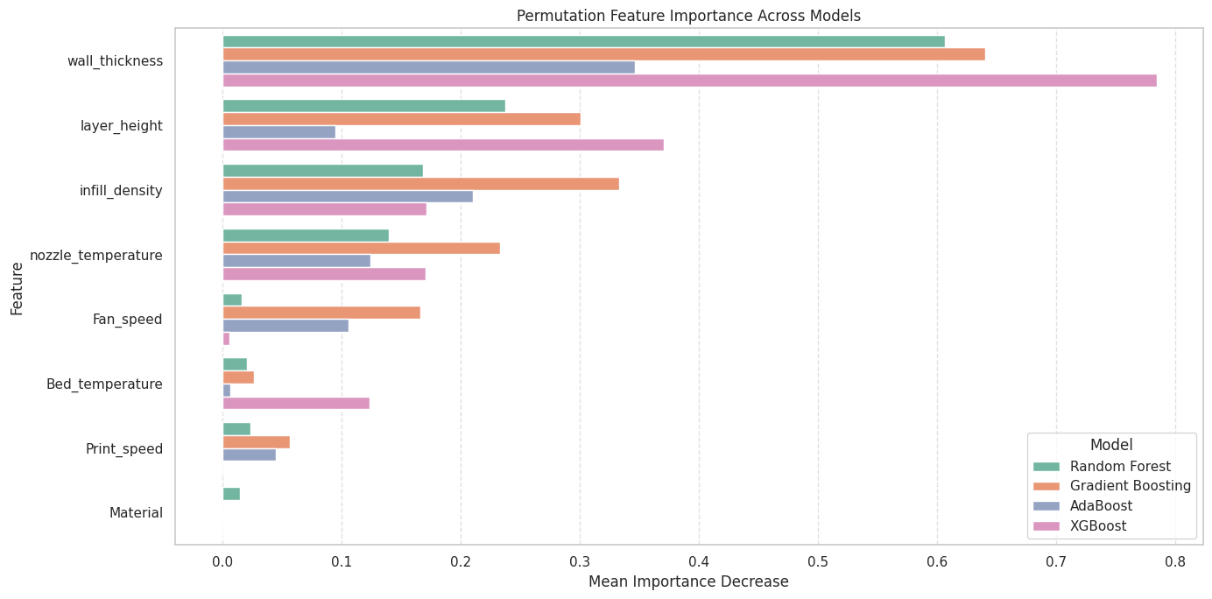

Slide 24
Future Work:
🧠 Advanced Models
Deep learning, AutoML, uncertainty intervals.
📊 Data & Scalability
IoT sensor data, multi-material testing, synthetic datasets.
🚀 Deployment
Web/API tool, edge AI for real-time control.

Slide 25
References
Delli, U., & Chang, S. (2018). Automated process monitoring in 3D printing using supervised machine learning. Procedia Manufacturing, 26, 865–870. https://doi.org/10.1016/j.promfg.2018.07.111
Jayasudha, M., Elangovan, M., Mahdal, M., & Priyadarshini, J. (2022). Accurate estimation of tensile strength of 3D printed parts using machine learning algorithms. Processes, 10(6), 1158. https://doi.org/10.3390/pr10061158
Tatar, A. B. (2025). Predicting three-dimensional (3D) printing product quality with machine learning-based regression methods. Fırat University Journal of Experimental and Computational Engineering, 4(1), 206–225. https://doi.org/10.62520/fujece.1604379
Sharma, P., Vaid, H., Vajpeyi, R., Shubham, P., Agarwal, K. M., & Bhatia, D. (2022). Predicting the dimensional variation of geometries produced through FDM 3D printing employing supervised machine learning. Sensors International, 3, 100194. https://doi.org/10.1016/j.sintl.2022.100194

